Slide 1


IOT SENSOR ANOMALY DETECTION PIPELINE
Building robust, scalable pipelines for real-time insights from sensor data.

Slide 2
TABLE OF CONTENTS
Project overview & Objective
Technical Specifications
Design solutions for building pipelines
High Level Design
Low Level Design
End-to-end IoT pipeline- Real-time processing and S3 archival
Error handling & Data quality checks
Pipeline Orchestration
Alerts/ Monitor/ Logging
Visualizations
Testing
Business impacts & Outcomes

Slide 3

1
PROJECT OVERVIEW & OBJECTIVE
This project builds a real-time IoT pipeline that streams sensor data through Amazon Kinesis and processes it in Databricks.
Curated datasets are stored in Delta Lake with versioning and governance enabled by Git & Unity Catalog.
The purpose is to achieve predictive maintenance by ensuring data quality and applying robust error handling.
Rolling z-score anomaly detection is performed across Bronze, Silver, and Gold layers, with alerts and monitoring for reliability.

Slide 4
2
TECHNICAL SPECIFICATIONS
Kaggle IoT JSON dataset streamed in real-time via Amazon Kinesis and stored in S3.
Processed in Databricks using PySpark and Delta Lake on autoscaling, high-concurrency clusters (8–32 workers, m5.xlarge).
Data stored in Bronze (raw), Silver (validated), and Gold (analytics) layers with Unity Catalog governance.Ensures data quality with cleansing, z-score anomaly detection, error handling, checkpointing, Slack alerts, and anomaly logs.
Delivers predictive maintenance, reduced downtime, and improved operational efficiency with lower costs.

Slide 5

3
DESIGN SOLUTIONS FOR BUILDING PIPELINES
HLD
LLD

Slide 6
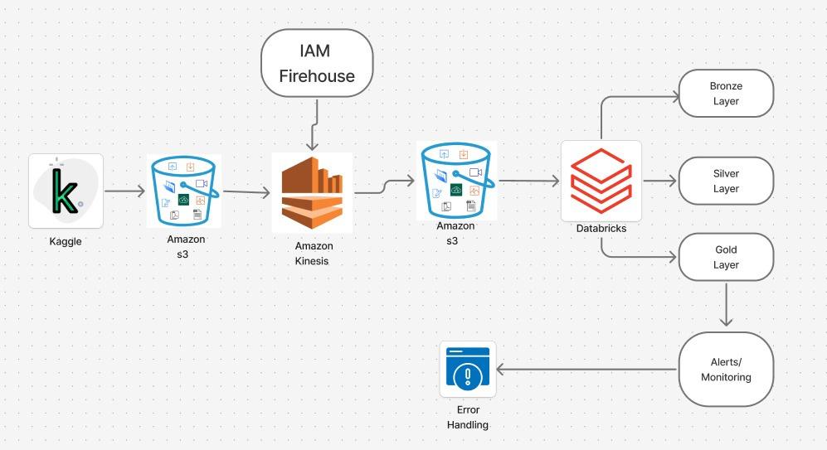
HIGH LEVEL DESIGN
4

Slide 7
5
LOW LEVEL DESIGN
Ingested Kaggle AnoML-IoT JSON into S3, streamed via Lambda → Kinesis.
Stored real-time events in Kinesis with raw backups in S3.
Applied error handling & data quality checks (validation, uniqueness, rolling metrics).
Enabled alerts & auditing using Delta Lake transaction logs.
Designed visualizations with Git-based version control for monitoring & reproducibility.

Slide 8
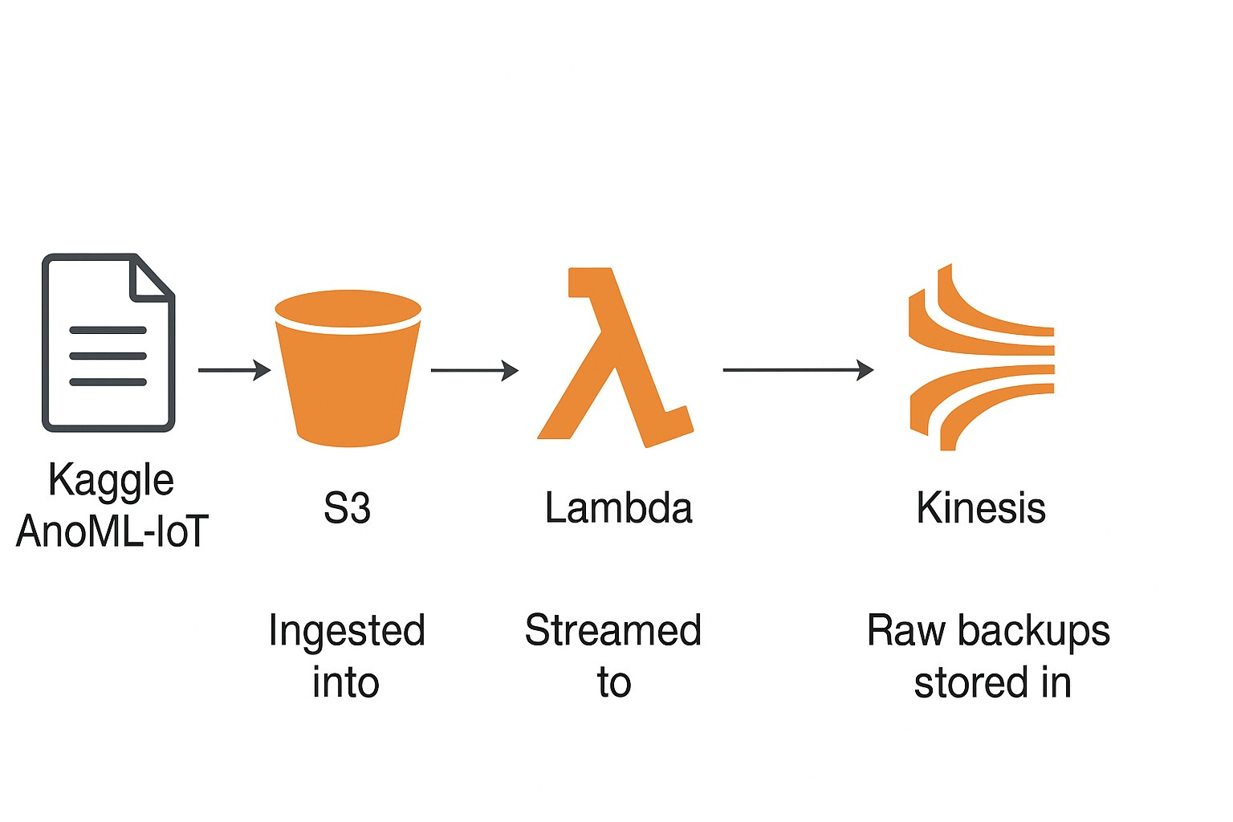
6
END-TO-END IOT PIPELINE – REAL TIME PROCESSING AND S3 ARCHIVAL

Slide 9
ERROR HANDLING& DATA QUALITY CHECKS
7
Try/Except with Logging in Databricks – Wraps critical Spark operations to catch runtime errors and logs them for analysis.
Data Validation and Cleansing: Ensures incoming JSON data conforms to the expected schema, removes missing or invalid fields, filters out corrupted or nonsensical sensor readings, and eliminates duplicates based on device_id and timestamp.
Anomaly Detection Preparation: Performs range validation on sensor values (e.g., temperature, humidity) and calculates rolling metrics, such as 5-minute averages, to establish dynamic baselines for detecting outliers.

Slide 10
8
PIPELINE ORCHESTRATION
Workflow Management: Orchestrated using Databricks Workflows with continuous 10-second micro-batches for real-time streaming.
Error Handling & Alerts: Implements checkpointing for fault tolerance, logs errors and anomalies, and sends Slack notifications for critical events.
Version Control & Testing: GitHub integration ensures reproducibility; unit tests and batch-mode validation confirm pipeline correctness before deployment.

Slide 11
9
ALERTS / MONITORING / LOGGING
Error Logging: All ingestion and transformation errors are captured in iot_catalog.logs.anomaly_log for audit and troubleshooting.
Notification Delivery: Alert is sent via configured channel (e.g., email) to notify the support team.
Failure Detection: On error or failed run, Databricks triggers a failure event.

Slide 12
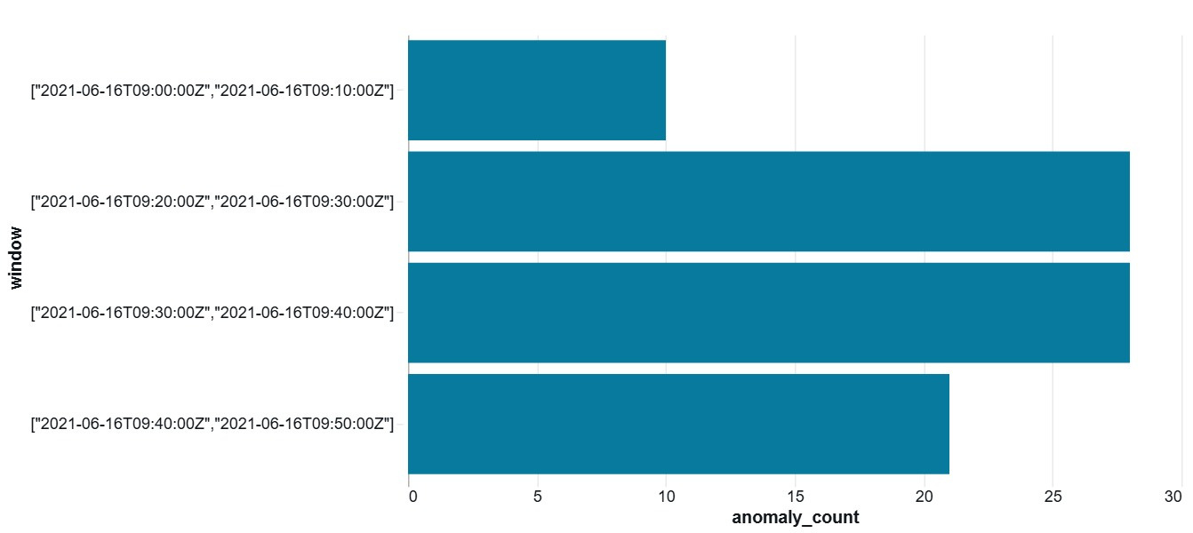
VISUALIZATIONS
10
Anamoly Rate (10mins buckets)

Slide 13
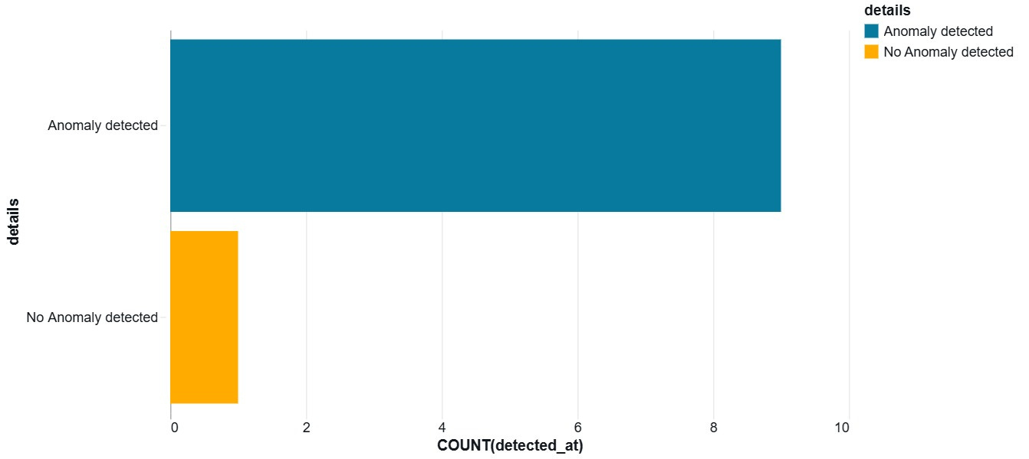
VISUALIZATIONS
11
Anomaly Counts For 10 rows

Slide 14
12
TYPE OF TESTING DONE
Unit Testing → Verified schema, cleansing rules, and anomaly detection logic.
Integration Testing → Validated end-to-end Bronze → Silver → Gold flow using sample batch files.
Validation → Ensured checkpoint recovery, alerts, and overall pipeline stability.

Slide 15
BUSINESS IMPACTS & OUTCOMES
13
Early Anomaly Detection: Identifies abnormal sensor behavior in real-time, reducing equipment downtime and maintenance costs.
Data-Driven Decision Making: Provides reliable, high-quality metrics and alerts for better monitoring and strategic planning.
Scalable Operations: Handles high-velocity IoT data streams, ensuring consistent performance as the network of sensors grows.
Regulatory & Audit Compliance: Maintains detailed logs, checkpoints, and data quality measures for traceability and reporting.

Slide 16
THANK YOU

